Slide 1

ONTORPONTHIK
person
person
person
Arfatul Islam Asif
Dept of Computer Science and Engineering, SUST
Unayes Ahmed Khan
Dept of Computer Science and Engineering, SUST
Mutaher Ahmed Shakil
Dept of Industrial and Production Engineering, SUST

Slide 2

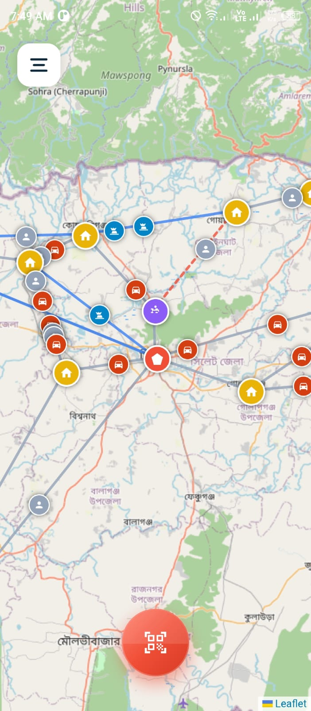
DigitalDelta
Digital Delta is a disaster-response logistics mobile app designed for flood-prone regions. It helps responders visualize the relief network, identify blocked routes, optimize delivery paths, simulateML-assisted flood prediction, manage inventory, and fall back to air-drop delivery when the ground network becomes unreachable.

Slide 3

The Challenges of Disaster Management
inventory
analytics
signal_wifi_off
Inventory Management
Inefficient tracking and allocation of relief supplies often lead to resource waste or critical shortages in affected areas.
Data Scarcity
A lack of accurate, field-level data makes it difficult for responders to assess needs and make informed decisions quickly.
Infrastructure Failures
Disasters frequently destroy communication networks, leaving responders and victims without internet or basic connectivity.

Slide 4

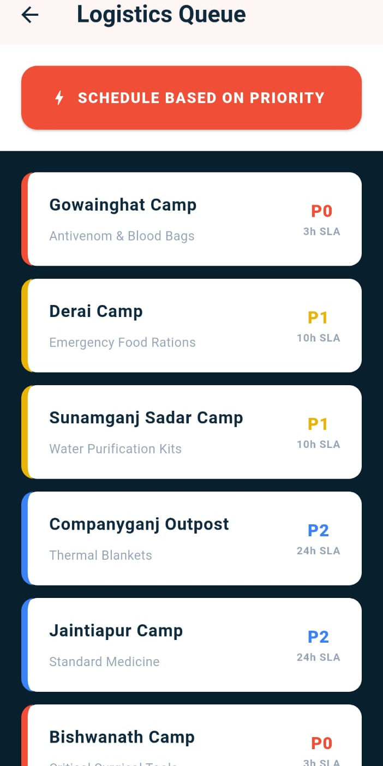
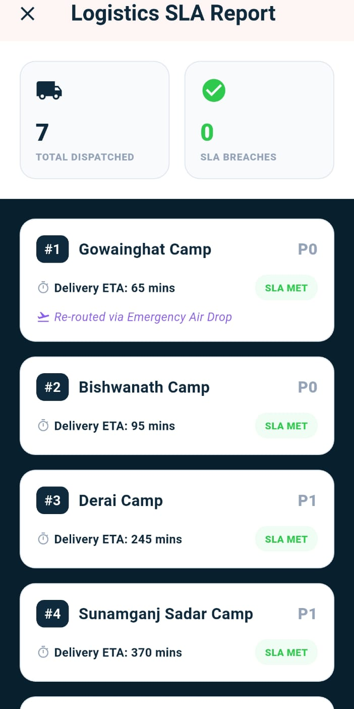
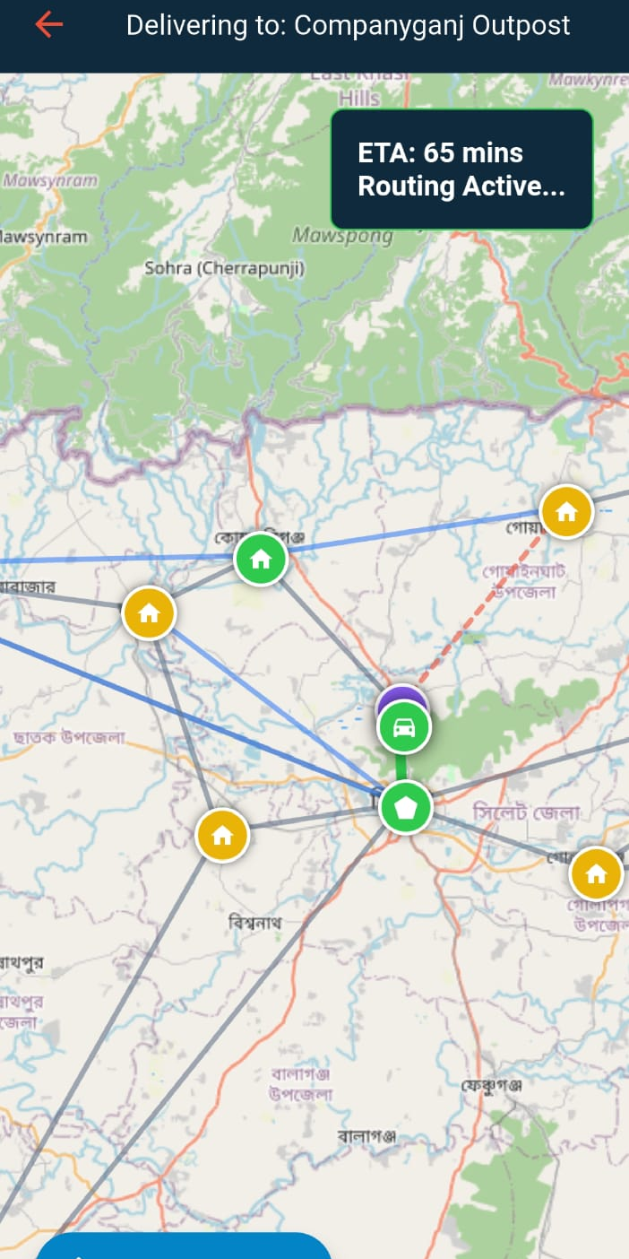
The Solution: A Mobile Response App
Designed to address critical needs through real-time logistics and predictive insights.
Logistics Queue
SLA Reporting
Route Mapping

Slide 5
Let's Analyze the Stakeholders
inventory
groups
account_balance
airplanemode_active
admin_panel_settings
Supply Manager
Responsible for inventory tracking, resource allocation, and supply chain oversight during disaster relief efforts.
Field Volunteer
Operates at the ground level, distributing aid, gathering field data, and providing immediate assistance to victims.
Camp Commander
Coordinates shelter operations, manages camp safety, and oversees the general welfare of displaced populations.
Drone Operator
Utilizes aerial technology for terrain mapping, damage assessment, and potentially locating survivors in remote areas.
Sync Admin
Manages data synchronization across networks, ensuring critical info flows between field units and central command.

Slide 6
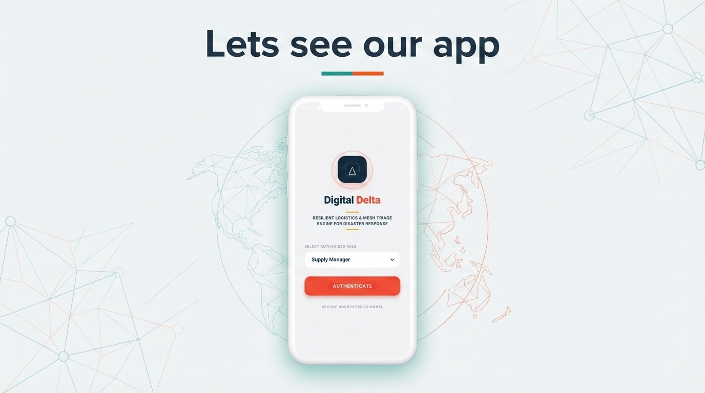

Slide 7
Tech Stack
phone_iphone
map
storage
Mobile app
Flutter | Dart
Geospatial
Leaflet.js
Storage
SQLite

Slide 8


